Slide 1
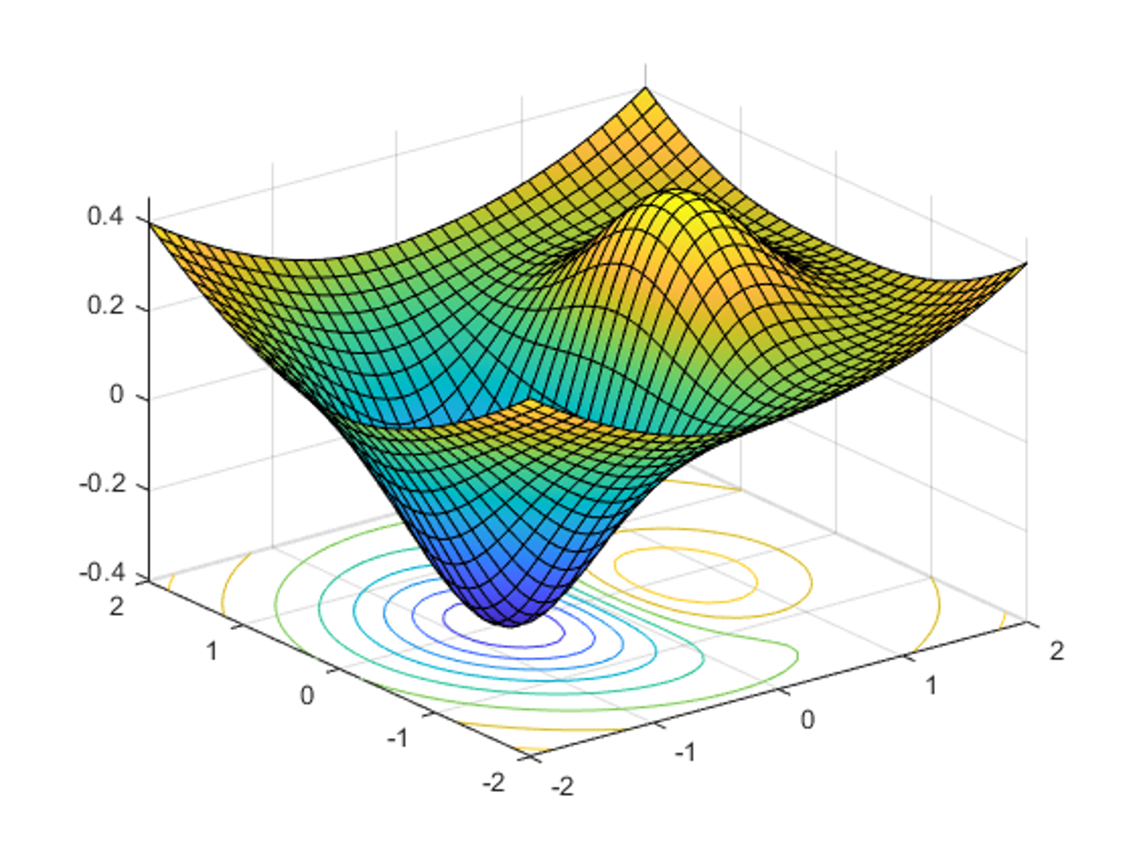


DATA 585 Optimization
Picture generated on MATLAB using
f = @(x,y) x.*exp(-x.^2-y.^2)+(x.^2+y.^2)/20;
fsurf(f,[-2,2],'ShowContours','on’)
Code example from https://www.mathworks.com/help/optim/ug/optimization-toolbox-tutorial.html
Instructor: Yves Lucet
$$\min{\{f\left(x\right):g\left(x\right)≤0;h\left(x\right)=0;x∈S\}}$$
We respectfully acknowledge the Syilx Okanagan Nation and their peoples, in whose traditional, ancestral, unceded territory UBC Okanagan is situated.

Slide 2

Menu: 1D
Derivative
Fermat
Minimizer local/global and convexity
Gradient descent
Backtracking
Newton
Image courtesy of Gregory Szarkiewicz / FreeDigitalPhotos.net

Slide 3
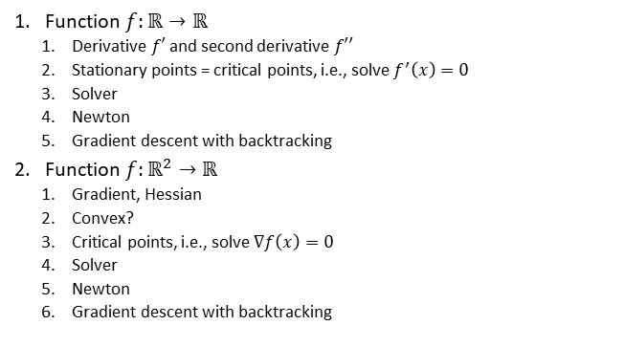
Lab 2
Function $f:ℝ→ℝ$
Derivative $f′$ and second derivative $f′′$
Stationary points = critical points, i.e., solve $f^{′}\left(x\right)=0$
Solver
Newton
Gradient descent with backtracking
Function $f:ℝ^{2}→ℝ$
Gradient, Hessian
Convex?
Critical points, i.e., solve $∇f\left(x\right)=0$
Solver
Newton
Gradient descent with backtracking

Slide 4
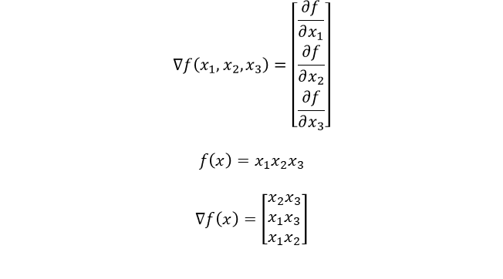
Gradient
$$∇f\left(x_{1},x_{2},x_{3}\right)=\left[\begin{matrix}\frac{∂f}{∂x_{1}} \\ \frac{∂f}{∂x_{2}} \\ \frac{∂f}{∂x_{3}}\end{matrix}\right]$$
$$f\left(x\right)=x_{1}x_{2}x_{3}$$
$$∇f\left(x\right)=\left[\begin{matrix}x_{2}x_{3} \\ x_{1}x_{3} \\ x_{1}x_{2}\end{matrix}\right]$$

Slide 5
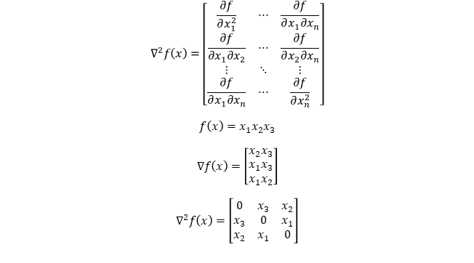
Hessian
$$∇^{2}f\left(x\right)=\left[\begin{matrix}\frac{∂f}{∂x_{1}^{2}} & ⋯ & \frac{∂f}{∂x_{1}∂x_{n}} \\ \frac{∂f}{∂x_{1}∂x_{2}} & ⋯ & \frac{∂f}{∂x_{2}∂x_{n}} \\ ⋮ & ⋱ & ⋮ \\ \frac{∂f}{∂x_{1}∂x_{n}} & ⋯ & \frac{∂f}{∂x_{n}^{2}}\end{matrix}\right]$$
$$f\left(x\right)=x_{1}x_{2}x_{3}$$
$$∇f\left(x\right)=\left[\begin{matrix}x_{2}x_{3} \\ x_{1}x_{3} \\ x_{1}x_{2}\end{matrix}\right]$$
$$∇^{2}f\left(x\right)=\left[\begin{matrix}0 & x_{3} & x_{2} \\ x_{3} & 0 & x_{1} \\ x_{2} & x_{1} & 0\end{matrix}\right]$$

Slide 6
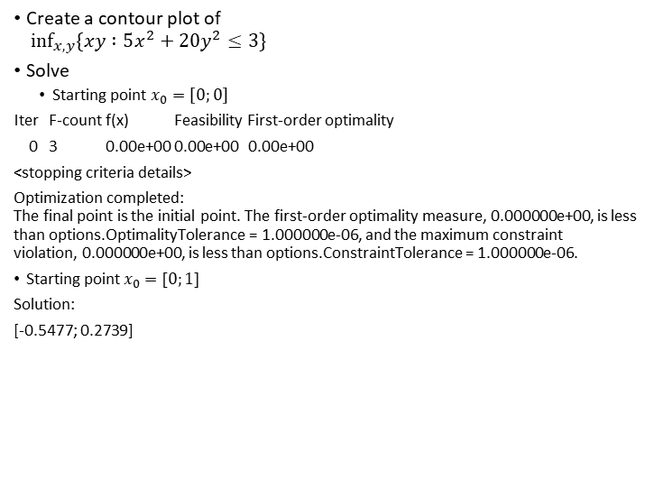
Create a contour plot of $\inf_{x,y}{\{xy :5x^{2}+20y^{2}≤3\}}$
Solve
Starting point $x_{0}=\left[0;0\right]$
Iter F-count f(x) Feasibility First-order optimality
0 3 0.00e+00 0.00e+00 0.00e+00
<stopping criteria details>
Optimization completed: The final point is the initial point. The first-order optimality measure, 0.000000e+00, is less than options.OptimalityTolerance = 1.000000e-06, and the maximum constraint violation, 0.000000e+00, is less than options.ConstraintTolerance = 1.000000e-06.
Starting point $x_{0}=[0;1]$
Solution:
[-0.5477; 0.2739]
Iter | F-count | f(x) | Feasibility | optimality | stepsize
0 | 3 | 0.00E+00 | 1.70E+01 | 1.00E+00
1 | 6 | -5.48E-01 | 8.00E+00 | 7.52E-01 | 1.10E+00
2 | 9 | -1.32E-01 | 0.00E+00 | 1.72E-01 | 5.60E-01
3 | 12 | -5.99E-02 | 0.00E+00 | 8.47E-02 | 2.11E-01
4 | 15 | -1.30E-01 | 0.00E+00 | 2.48E-02 | 1.96E-01
5 | 18 | -1.31E-01 | 0.00E+00 | 1.92E-02 | 3.04E-03
6 | 21 | -1.50E-01 | 9.24E-03 | 1.34E-03 | 4.24E-02
7 | 24 | -1.50E-01 | 0.00E+00 | 3.75E-04 | 1.73E-03
8 | 27 | -1.50E-01 | 0.00E+00 | 2.00E-04 | 2.86E-04
9 | 30 | -1.50E-01 | 0.00E+00 | 4.00E-05 | 3.26E-04
10 | 33 | -1.50E-01 | 0.00E+00 | 3.97E-07 | 8.07E-05

Slide 7
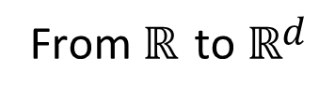
From $ℝ$ to $ℝd$
2

Slide 8
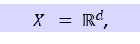

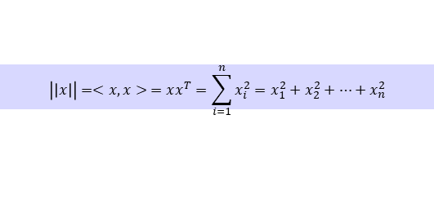
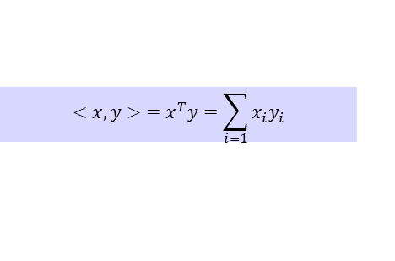
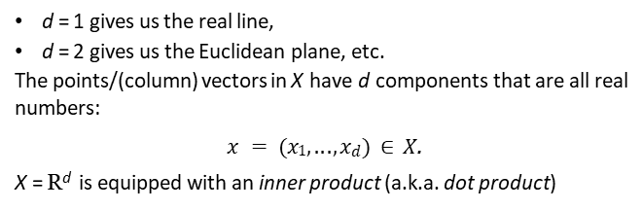
$$X = ℝd$$
From now on, the underlying space is the d -dimensional Euclidean space
$X = ℝd$,
d = 1 gives us the real line,
d = 2 gives us the Euclidean plane, etc.
The points/(column) vectors in X have d components that are all real numbers:
$x = (x1, . . . , xd ) ∈ X$.
X = R^{d} is equipped with an inner product (a.k.a. dot product)
d
$$<x,y> =x^{T}y=\sum_{i=1}{x_{i}y_{i}}$$
and a norm (a.k.a. length)
$$\left|\left|x\right|\right|=<x,x> =xx^{T}=\sum_{i=1}^{n}{x_{i}^{2}}=x_{1}^{2}+x_{2}^{2}+…+x_{n}^{2}$$
We have: $0≤|\left|x\right||$ with equality $⇔x=0$. $\left|\left|αx\right|\right|=\left|α\right|.|\left|x\right||$
$\left|\left|x+y\right|\right|≤\left|\left|x\right|\right|+|\left|y\right||$ (triangle inequality)
3

Slide 9

Optimization
As before,
$$f : X → ℝ$$
We will assume that our optimization problem (P) is to
minimize f (x ) over x ∈ X .
The function f is called the objective function. The solutions to (P), which are vectors/points in X , are called minimizers. The best possible value is the minimum or minimal/optimal value.

Slide 10
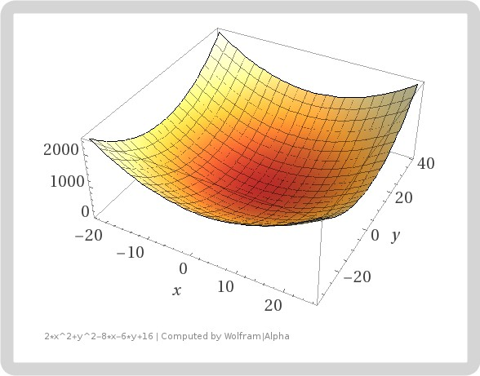
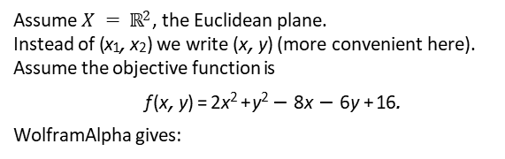
Example
Assume $X = ℝ2$, the Euclidean plane.
Instead of (x₁, x₂) we write (x, y ) (more convenient here).
Assume the objective function is
f (x, y ) = 2x ² + y ² − 8x − 6y + 16.
WolframAlpha gives:
Visually, it looks like f has a unique minimizer somewhere close to the origin (0, 0).

Slide 11

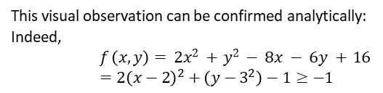
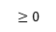
Example (continued)
This visual observation can be confirmed analytically: Indeed,
$$f \left(x, y \right)= 2x 2 + y 2 − 8x − 6y + 16 \\ =2{\left(x−2\right)}^{2}+\left(y−3^{2}\right)−1≥−1$$
$$≥0$$
$$≥0$$
and also f (x, y ) = −1 ⇔ (x, y ) = (2, 3).
This proves that (x, y ) = (2, 3) is the unique minimizer, and that the optimal/minimal value is f (2, 3) = −1.
As in the one-dimensional case, this proof requires insight — the “right way” to look at the objective function that reveals the minimizer and the optimal value.
So what do we do if we lack this insight?

Slide 12

Calculus (in $ℝd$ ) revisited

Slide 13
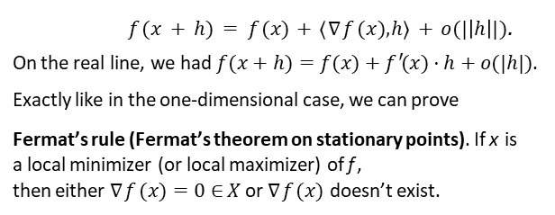
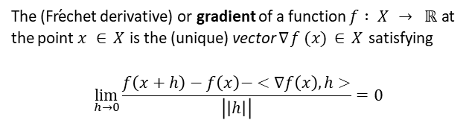
The gradient and Fermat’s rule
The (Fr´echet derivative) or gradient of a function $f : X → ℝ$at the point $x ∈ X$is the (unique) vector $∇f (x ) ∈ X$satisfying
$$\lim_{h→0}{\frac{f\left(x+h\right)−f\left(x\right)− <∇f\left(x\right),h>}{\left|\left|h\right|\right|}=0}$$
i.e.,
$f (x + h) = f (x ) + ⟨∇f (x ), h⟩ + o(|\left|h\right||)$.
On the real line, we had $f(x+h)=f(x)+f ′(x )·h+o(|h|)$. Exactly like in the one-dimensional case, we can prove
Fermat’s rule (Fermat’s theorem on stationary points). If x is a local minimizer (or local maximizer) of f ,
then either $∇f(x)=0∈X$ or $∇f(x)$ doesn’t exist.

Slide 14
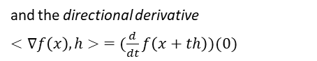
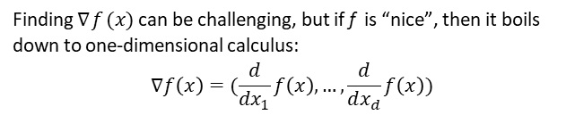
Partial derivatives
Finding $∇f(x)$can be challenging, but if f is “nice”, then it boils down to one-dimensional calculus:
$$∇f\left(x\right)=(\frac{d}{dx_{1}}f\left(x\right),…,\frac{d}{dx_{d}}f\left(x\right))$$
and the directional derivative
$<∇f\left(x\right),h> =(\frac{d}{dt}f\left(x+th\right))(0)$
where h ∈ X .
No worries if you are rusty on Calculus III: Software can help to find gradients, and for algorithms we just need a “black box” — we often don’t need to know their precise analytical form.

Slide 15
Example (continued)
Consider again the example from above:
f (x, y ) = 2x ² + y ² − 8x − 6y + 16. This function is differentiable everywhere; indeed,
d
d
f (x, y ) = 4x − 8 and f (x, y ) = 2y − 6; hence,
dx dy
∇f (x, y ) = (4x − 8, 2y − 6).
(Actually, the gradient is a column vector but for convenience we often write it as a row vector.)
In light of Fermat’s rule, we set the gradient equal to 0 ∈ X and solve for x and y : 4x − 8 = 0 and 2y − 6 = 0; equivalently,
(x, y ) = (2, 3)
is thus the only stationary point.
Again, the issue now is: how do we guarantee/verify that (x, y ) = (2, 3) is a minimizer?

Slide 16
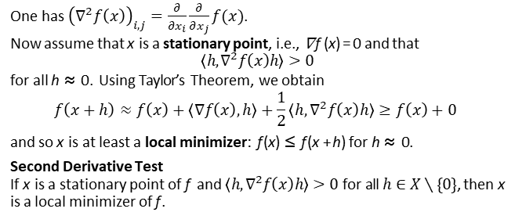
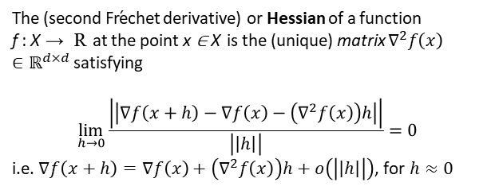
The Hessian
The (second Fr´echet derivative) or Hessian of a function
f : X → R at the point x ∈ X is the (unique) matrix $∇^{2}f\left(x\right)∈ℝ^{d×d}$ satisfying
$$\lim_{h→0}{\frac{\left|\left|∇f\left(x+h\right)−∇f\left(x\right)−\left(∇^{2}f\left(x\right)\right)h\right|\right|}{\left|\left|h\right|\right|}=0}$$
i.e. $∇f\left(x+h\right)=∇f\left(x\right)+\left(∇^{2}f\left(x\right)\right)h+o\left(\left|\left|h\right|\right|\right)$, for $h≈0$
One has ${\left(∇^{2}f\left(x\right)\right)}_{i,j}=\frac{∂}{∂x_{i}}\frac{∂}{∂x_{j}}f(x)$.
Now assume that x is a stationary point, i.e., ∇f (x ) = 0 and that $$\left\langle h,∇^{2}f\left(x\right)h\right\rangle >0$$
for all h ≈ 0. Using Taylor’s Theorem, we obtain
$$f\left(x+h\right)≈f\left(x\right)+\left\langle ∇f\left(x\right),h\right\rangle +\frac{1}{2}\left\langle h,∇^{2}f\left(x\right)h\right\rangle ≥f\left(x\right)+0$$
and so x is at least a local minimizer: f (x ) ≤ f (x + h) for h ≈ 0.
Second Derivative Test
If x is a stationary point of f and $\left\langle h,∇^{2}f\left(x\right)h\right\rangle >0$ for all $h∈X∖\{0\}$, then x is a local minimizer of f .
11

Slide 17
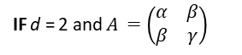
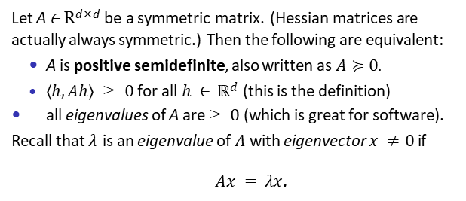
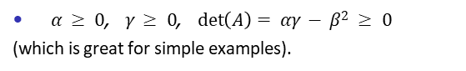
Positive semidefinite Matrices
Let A ∈ R^{d×d} be a symmetric matrix. (Hessian matrices are actually always symmetric.) Then the following are equivalent:
A is positive semidefinite, also written as $A≽0.$
$⟨h, Ah⟩ ≥ 0$for all $h ∈ ℝd$(this is the definition)
all eigenvalues of A are $≥ 0$ (which is great for software). Recall that $λ$ is an eigenvalue of $A$ with eigenvector $x ≠ 0$if
$Ax = λx$.
IF d = 2 and $A =\left(\begin{matrix}α & β \\ β & γ\end{matrix}\right)$
then we can add to this list
$α ≥ 0$, $γ ≥ 0$, $\det\left(A\right)= αγ − β2 ≥ 0$ (which is great for simple examples).
12

Slide 18
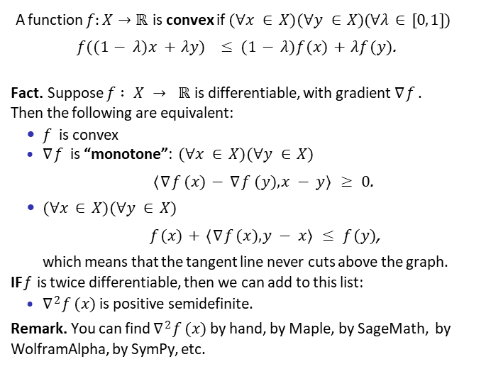
Convex functions on X
A function $f:X→ℝ$is convex if $(∀x ∈ X )(∀y ∈ X )(∀λ ∈ [0, 1])$
$f((1 − λ)x + λy) ≤ (1 − λ)f (x ) + λf (y )$.
Fact. Suppose $f : X → ℝ$is differentiable, with gradient $∇f$ . Then the following are equivalent:
$f$ is convex
$∇f$ is “monotone”: $(∀x ∈ X )(∀y ∈ X )$
$⟨∇f (x ) − ∇f (y ), x − y⟩ ≥ 0$.
$(∀x ∈ X )(∀y ∈ X )$
$f (x ) + ⟨∇f (x ), y − x⟩ ≤ f (y )$,
which means that the tangent line never cuts above the graph.
IF f is twice differentiable, then we can add to this list:
$∇2f (x )$is positive semidefinite.
Remark. You can find $∇2f (x )$by hand, by Maple, by SageMath, by WolframAlpha, by SymPy, etc.

Slide 19
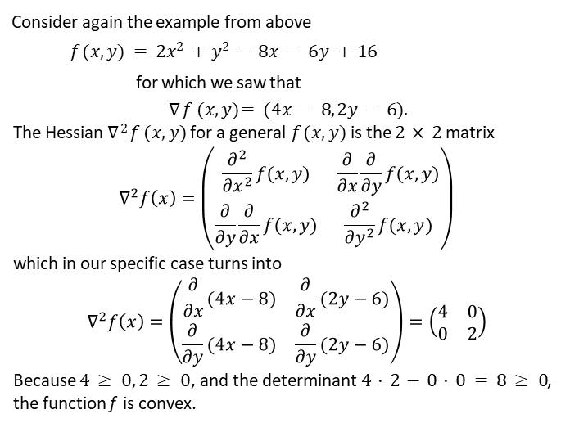
Example (continued)
Consider again the example from above
$$f (x, y ) = 2x 2 + y 2 − 8x − 6y + 16$$ for which we saw that
$$∇f (x, y )= (4x − 8, 2y − 6).$$
The Hessian $∇2f (x, y )$for a general $f (x, y )$is the $2 × 2$matrix
$$∇^{2}f\left(x\right)=\left(\begin{matrix}\frac{∂^{2}}{∂x^{2}}f(x,y) & \frac{∂}{∂x}\frac{∂}{∂y}f(x,y) \\ \frac{∂}{∂y}\frac{∂}{∂x}f(x,y) & \frac{∂^{2}}{∂y^{2}}f(x,y)\end{matrix}\right)$$
which in our specific case turns into
$$∇^{2}f\left(x\right)=\left(\begin{matrix}\frac{∂}{∂x}(4x−8) & \frac{∂}{∂x}(2y−6) \\ \frac{∂}{∂y}(4x−8) & \frac{∂}{∂y}(2y−6)\end{matrix}\right)=\left(\begin{matrix}4 & 0 \\ 0 & 2\end{matrix}\right)$$
Because $4 ≥ 0, 2 ≥ 0$, and the determinant $4 · 2 − 0 · 0 = 8 ≥ 0$, the function f is convex.

Slide 20
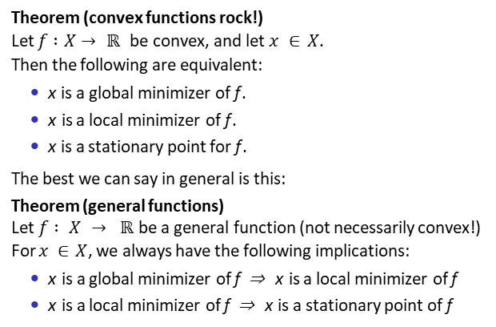
Convex functions rock — general functions don’t!
Theorem (convex functions rock!) Let $f :X→ℝ$be convex, and let $x ∈ X$.
Then the following are equivalent:
x is a global minimizer of f .
x is a local minimizer of f .
x is a stationary point for f .
The best we can say in general is this:
Theorem (general functions)
Let $f : X → ℝ$be a general function (not necessarily convex!) For $x ∈ X$, we always have the following implications:
x is a global minimizer of f ⇒ x is a local minimizer of f
x is a local minimizer of f ⇒ x is a stationary point of f

Slide 21
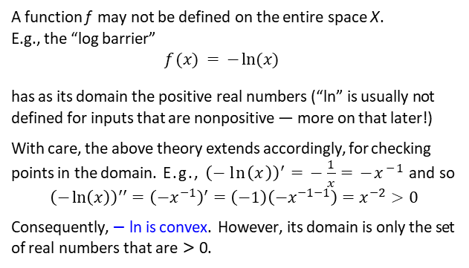
Domains smaller than the entire space
A function f may not be defined on the entire space X . E.g., the “log barrier”
$$f (x ) = − ln⁡(x )$$
has as its domain the positive real numbers (“ln” is usually not defined for inputs that are nonpositive — more on that later!)
With care, the above theory extends accordingly, for checking points in the domain. E.g., ${\left(−\ln\left(x\right)\right)}^{′}=−\frac{1}{x}=−x^{−1}$ and so
$${\left(−\ln\left(x\right)\right)}^{′′}={\left(−x^{−1}\right)}^{′}=\left(−1\right)\left(−x^{−1−1}\right)=x^{−2}>0$$
Consequently, − ln is convex. However, its domain is only the set of real numbers that are > 0.

Slide 22
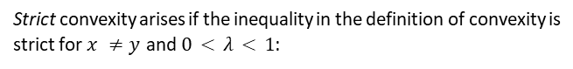
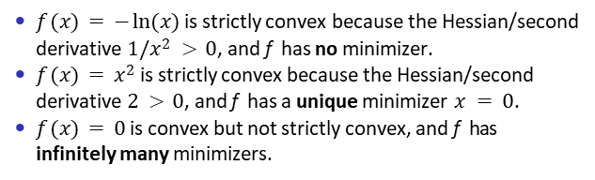
Strict convexity
Strict convexity arises if the inequality in the definition of convexity is strict for $x ≠ y$and $0 < λ < 1$:
$$f((1−λ)x+λy)<(1 − λ)f (x ) + λf (y ).$$
Now if both x and y were two different minimizers of f , then strict convexity would give that the points between x and y have even smaller functions values — which is absurd! Hence
a strictly convex function has either no or a unique minimizer! A sufficient condition for strict convexity of f is that the Hessian
2
∇ f is always positive definite (more on this in a minute).
$f (x ) = − ln⁡(x )$is strictly convex because the Hessian/second derivative $1/x 2 > 0$, and f has no minimizer.
$f (x ) = x 2$is strictly convex because the Hessian/second derivative $2 > 0$, and f has a unique minimizer $x = 0$.
$f (x ) = 0$is convex but not strictly convex, and f has
infinitely many minimizers.

Slide 23
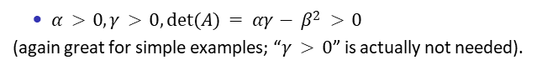
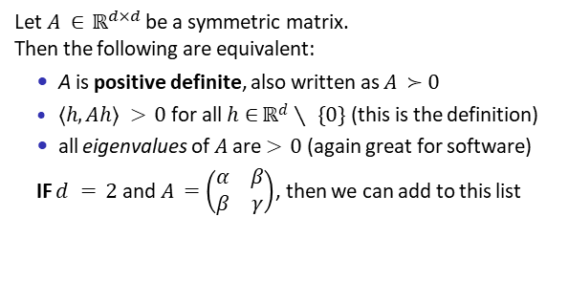
Positive definite Matrices
Let $A ∈ ℝ^{d×d}$ be a symmetric matrix. Then the following are equivalent:
A is positive definite, also written as $A ≻0$
$⟨h, Ah⟩ > 0$for all $h∈ℝd∖\{0\}$(this is the definition)
all eigenvalues of $A$ are $> 0$ (again great for software)
IF $d = 2$and $A =\left(\begin{matrix}α & β \\ β & γ\end{matrix}\right)$, then we can add to this list
$α > 0, γ > 0, det⁡(A) = αγ − β2 > 0$
(again great for simple examples; “$γ > 0$” is actually not needed).

Slide 24
WolframAlpha Cheat Sheet
plotting:
gradient:
plot 2x^2+y^2-8x-6y+16 gradient 2x^2+y^2-8x-6y+16
hessian matrix 2x^2+y^2-8x-6y+16
Hessian:
minimize: minimize 2x^2+y^2-8x-6y+16

Slide 25
Minimization Algorithms

Slide 26
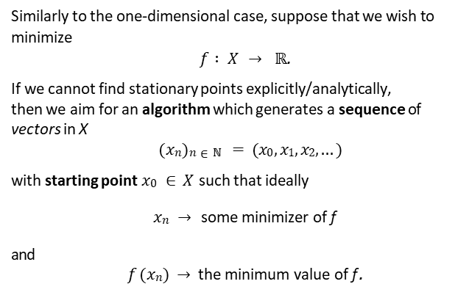
Minimization algorithms
Similarly to the one-dimensional case, suppose that we wish to minimize
$f : X → ℝ$.
If we cannot find stationary points explicitly/analytically,
then we aim for an algorithm which generates a sequence of
vectors in X
$$(xn)n∈ℕ = (x0, x1, x2, . . .)$$
with starting point $x0 ∈ X$such that ideally
$xn →$ some minimizer of f
and
$f (xn) →$the minimum value of f .

Slide 27
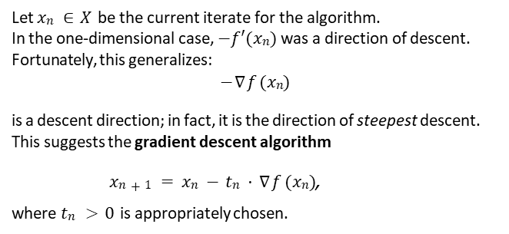
Descent direction and gradient descent
Let $xn ∈ X$be the current iterate for the algorithm.
In the one-dimensional case, $−f′(xn)$was a direction of descent. Fortunately, this generalizes:
$$−∇f (xn)$$
is a descent direction; in fact, it is the direction of steepest descent.
This suggests the gradient descent algorithm
$xn+1 = xn − tn · ∇f (xn)$, where $tn > 0$ is appropriately chosen.

Slide 28
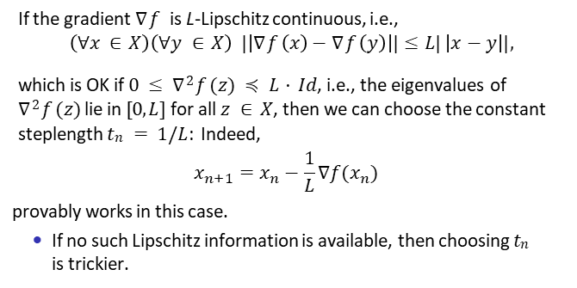
Finding t_{n} (Lipschitz-derivative case)
If the gradient $∇f$ is L-Lipschitz continuous, i.e.,
$$\left(∀x ∈ X \right)\left(∀y ∈ X \right) |\left|∇f\left(x \right)−∇f\left(y \right)\right||≤L|\left|x−y\right||,$$
which is OK if $0 ≤ ∇2f (z ) ≼ L · Id$, i.e., the eigenvalues of $∇2f (z )$lie in $[0, L]$for all $z ∈ X$, then we can choose the constant steplength $tn = 1/L$: Indeed,
$$x_{n+1}=x_{n}−\frac{1}{L}∇f(x_{n})$$
provably works in this case.
If no such Lipschitz information is available, then choosing $tn$
is trickier.

Slide 29

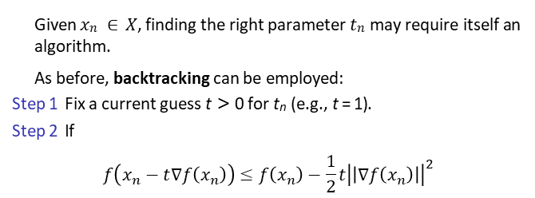
Finding t_{n} using backtracking
Given $xn ∈ X$ , finding the right parameter $tn$ may require itself an algorithm.
As before, backtracking can be employed:
Step 1 Fix a current guess t > 0 for t_{n} (e.g., t = 1).
Step 2 If
$$f\left(x_{n}−t∇f\left(x_{n}\right)\right)≤f\left(x_{n}\right)−\frac{1}{2}t{\left|\left|∇f\left(x_{n}\right)\right|\right|}^{2}$$
then RETURN $tn = t$;
Step 3 Otherwise, replace t by t/2 and return to Step 2.

Slide 30
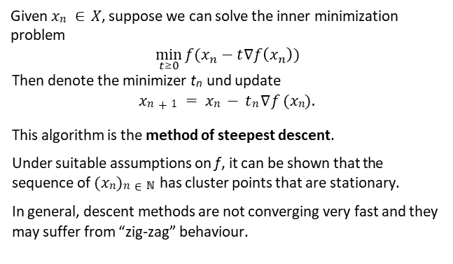
Finding t_{n} using an “inner” minimization
Given $xn ∈ X$, suppose we can solve the inner minimization problem
$$\min_{t≥0}{f(x_{n}−t∇f\left(x_{n}\right))}$$
Then denote the minimizer t_{n} und update
$$xn+1 = xn − tn∇f (xn).$$
This algorithm is the method of steepest descent.
Under suitable assumptions on f , it can be shown that the sequence of $(xn)n∈ℕ$has cluster points that are stationary.
In general, descent methods are not converging very fast and they may suffer from “zig-zag” behaviour.

Slide 31
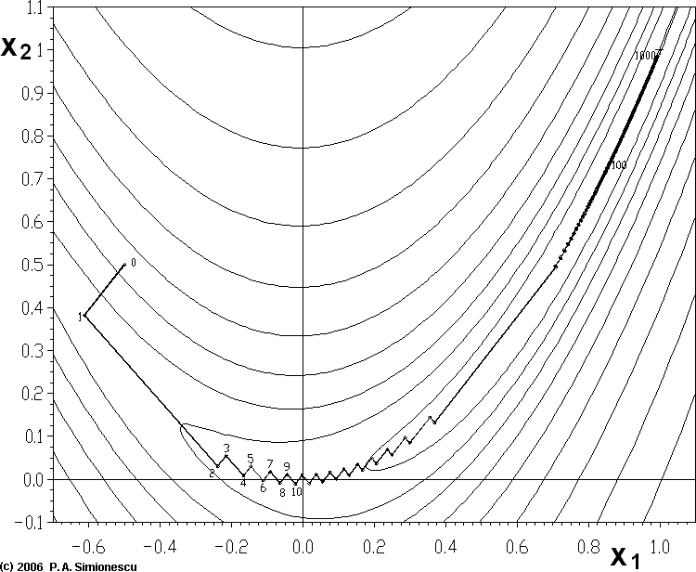
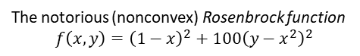
Rosenbrock function
The notorious (nonconvex) Rosenbrock function
$$f\left(x,y\right)={\left(1−x\right)}^{2}+100{\left(y−x^{2}\right)}^{2}$$
has a unique global minimizer at (x, y ) = (1, 1). Wikipedia has this
for “Gradient descent” as well as code; note the zig-zagging.

Slide 32
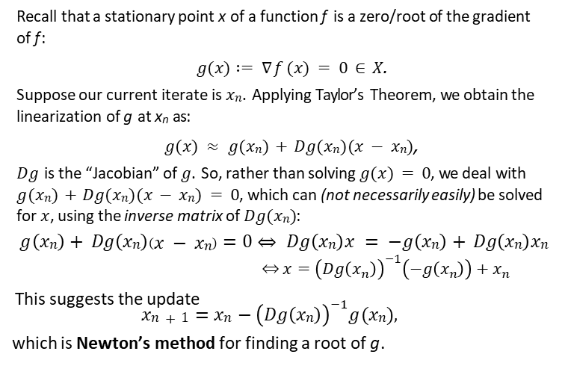
Roots of the gradient
Recall that a stationary point x of a function f is a zero/root of the gradient of f :
$g (x ) := ∇f (x ) = 0 ∈ X$.
Suppose our current iterate is $xn$. Applying Taylor’s Theorem, we obtain the linearization of g at x_{n} as:
$g (x ) ≈ g (xn) + Dg (xn)(x − xn)$,
$Dg$ is the “Jacobian” of $g$ . So, rather than solving $g (x ) = 0$, we deal with $g (xn) + Dg (xn)(x − xn) = 0$, which can (not necessarily easily) be solved for $x$ , using the inverse matrix of $Dg (xn)$:
$$g \left(xn\right)+ Dg \left(xn\right)\left(x − xn\right)=0⇔Dg \left(xn\right)x = −g \left(xn\right)+ Dg \left(xn\right)xn$$
$$⇔x={\left(Dg\left(x_{n}\right)\right)}^{−1}\left(−g\left(x_{n}\right)\right)+x_{n}$$
This suggests the update
$$xn+1=xn−{\left(Dg \left(xn\right)\right)}^{−1}g (xn),$$
which is Newton’s method for finding a root of g .
27

Slide 33
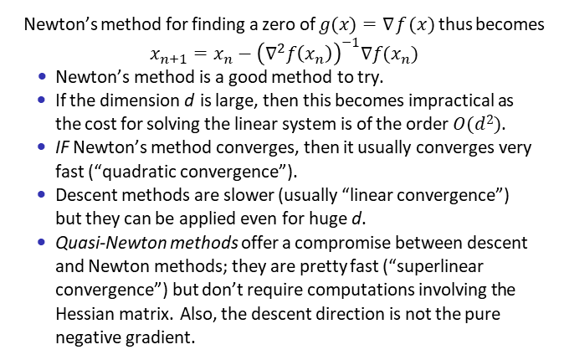
Newton’s method for finding stationary points
Newton’s method for finding a zero of $g (x )=∇f(x )$thus becomes
$$x_{n+1}=x_{n}−{\left(∇^{2}f\left(x_{n}\right)\right)}^{−1}∇f(x_{n})$$
Newton’s method is a good method to try.
If the dimension d is large, then this becomes impractical as the cost for solving the linear system is of the order $O(d 2)$.
IF Newton’s method converges, then it usually converges very fast (“quadratic convergence”).
Descent methods are slower (usually “linear convergence”) but they can be applied even for huge d .
Quasi-Newton methods offer a compromise between descent and Newton methods; they are pretty fast (“superlinear convergence”) but don’t require computations involving the Hessian matrix. Also, the descent direction is not the pure negative gradient.

Slide 34
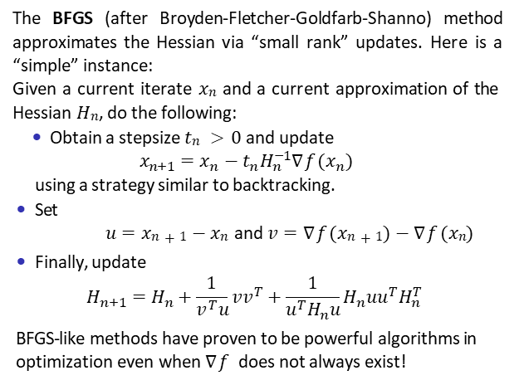
The BFGS method
The BFGS (after Broyden-Fletcher-Goldfarb-Shanno) method approximates the Hessian via “small rank” updates. Here is a “simple” instance:
Given a current iterate $xn$and a current approximation of the Hessian $Hn$, do the following:
Obtain a stepsize $tn > 0$and update
$$x_{n+1}=x_{n}−t_{n}H_{n}^{−1}∇f(x_{n})$$
using a strategy similar to backtracking.
Set
$u=xn+1−xn$and $v=∇f(xn+1)−∇f(xn)$
Finally, update
$$H_{n+1}=H_{n}+\frac{1}{v^{T}u}vv^{T}+\frac{1}{u^{T}H_{n}u}H_{n}uu^{T}H_{n}^{T}$$
BFGS-like methods have proven to be powerful algorithms in optimization even when $∇f$ does not always exist!

Slide 35

the Father of floating point 1989 Turing award
William Kahan, 1933-, Canadian
For his fundamental contributions to numerical analysis. One of the foremost experts on floating-point computations. Kahan has dedicated himself to
"making the world safe for numerical computations."

Slide 36
Class Goals
content
IEEE 754
learning objectives
identify errors due to rounding
describe IEEE 754

Slide 37
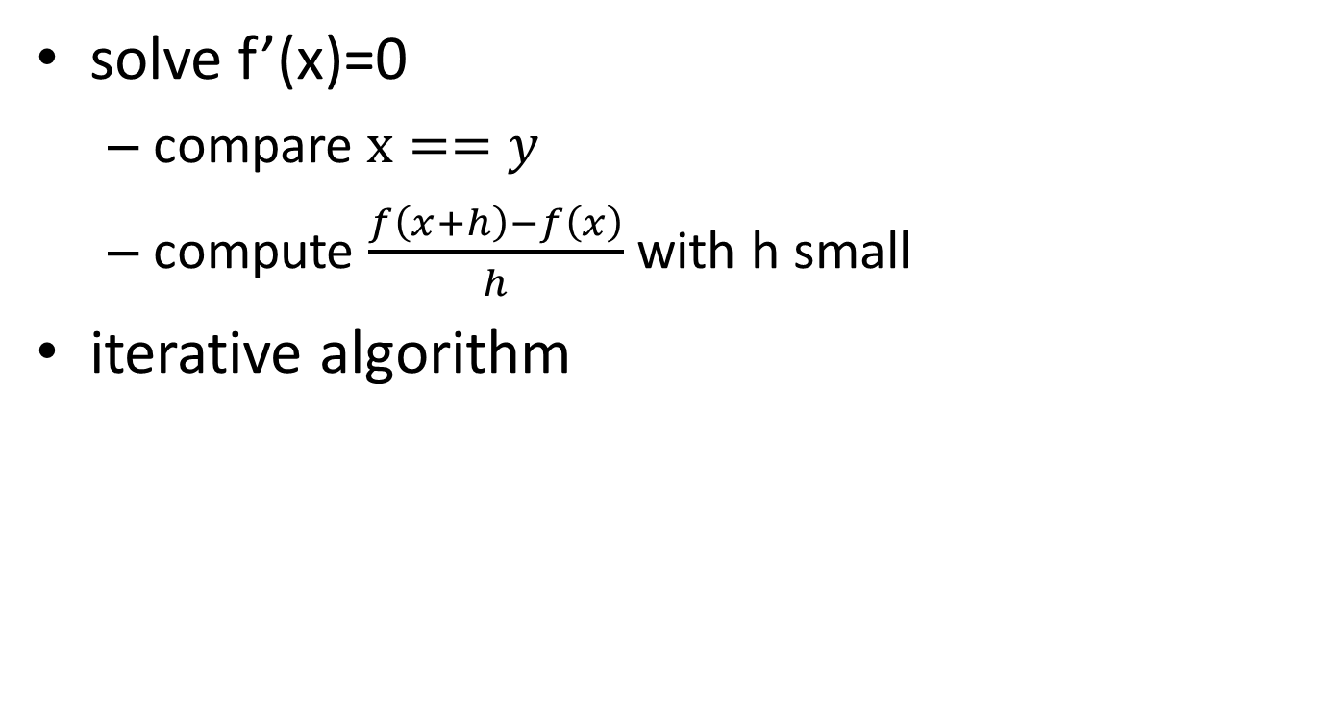
Optimization
solve f’(x)=0
compare $x==y$
compute $\frac{f\left(x+h\right)−f\left(x\right)}{h}$ with h small
iterative algorithm

Slide 38
Intuition
Floating point errors only occur for long complicated computation or large number of operations
Arithmetic rules always hold for floating point number
So we can relegate floating point issues to special cases handled by experts

Slide 39

WRONG

Slide 40
How do you explain?
x == y is true but X.equals(Y) is false [Java]
x/(1+x*x) * x= 0.0 but 1/(1/x+x) * x= 1.0
(x+y)+z=1.0 but x+(y+z)=0.0
Notes:
1st: == tests memory address but equals tests values. NOT QUITE! Here x=+0 and y=-0. But Equals uses floatToIntBits(float)
2nd: large values: x=10^300
3rd: large values: x=10^300 y=-10^300 z=1

Slide 41
f=-3; for i=1:LIMIT f=1.4*f-0.2*f^2+3; printf("%3.0f, f=%2.20f\n",i,f); end;
Scilab 5.4: f=4.99999999999999910000 after LIMIT>=106
Matlab: f=4.9999999999999982 for even after LIMIT>=104 f=5.0000000000000009 for odd
OOo Calc: f=5 after LIMIT>=49
Ms Excel 2010: f=5 after LIMIT>=80
Java: f=-3 until at least LIMIT<=1,000,000
WHO IS WRONG???
Notes:
Accumulation of rounding errors. Java is right. The others follow IEEE 754

Slide 42
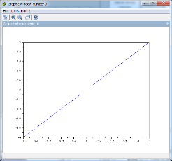
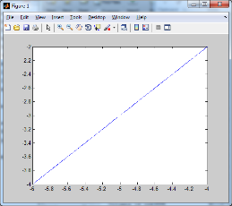
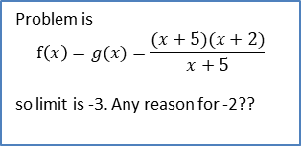
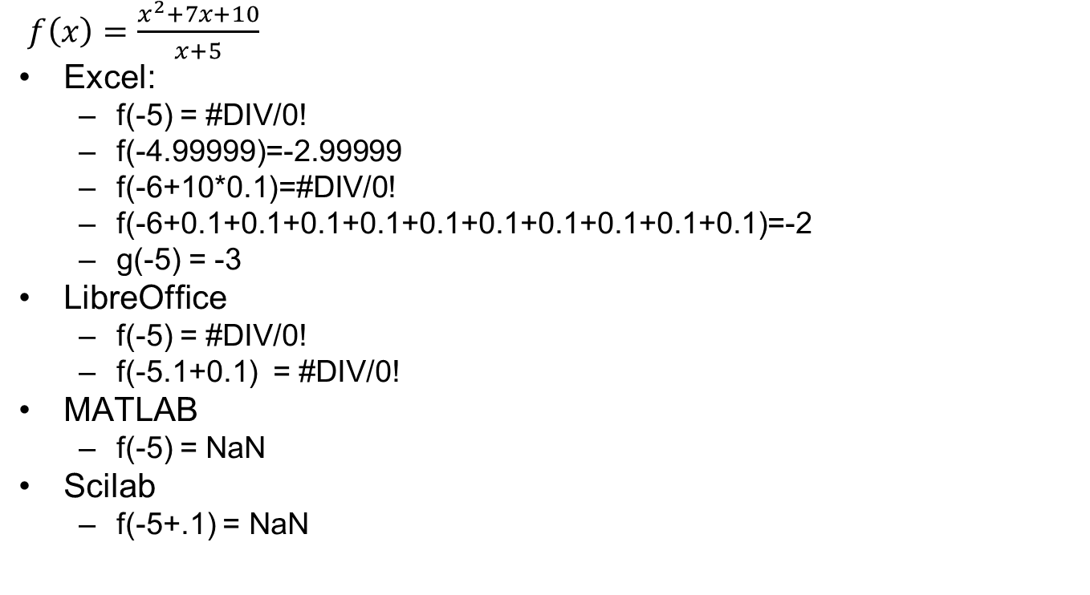
We got a problem
Problem is
$$f\left(x\right)=g(x)=\frac{(x+5)(x+2)}{x+5}$$
so limit is -3. Any reason for -2??
$f\left(x\right)=\frac{x^{2}+7x+10}{x+5}$
Excel:
f(-5) = #DIV/0!
f(-4.99999)=-2.99999
f(-6+10*0.1)=#DIV/0!
f(-6+0.1+0.1+0.1+0.1+0.1+0.1+0.1+0.1+0.1+0.1)=-2
g(-5) = -3
LibreOffice
f(-5) = #DIV/0!
f(-5.1+0.1) = #DIV/0!
MATLAB
f(-5) = NaN
Scilab
f(-5+.1) = NaN
Notes:
mathematically, the function is x+2 everywhere except at x=-5 where it is not defined

Slide 43
Java investigation
After converting to binary and back:
x=-5.4+.1+.1+.1+.1=-5.0000005
Numerator: y1=1.9073486E-6
Denominator: y2=-4.7683716E-7
Ratio: y1/y2 = -4
We are really computing 0/0 which is an extremely unstable computation. Various software use different algorithms to do that computation. The order of the operations and the exact operations all lead to different results. None of them is a bug. The users should really know what they are doing.

Slide 44
Solve
round to 4 digits

Slide 45
Solve (cont)
So
BUT!

Slide 46
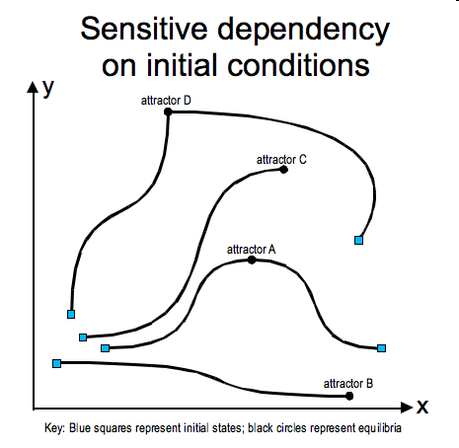

Issues
rounding error
stability
conditioning

Slide 47
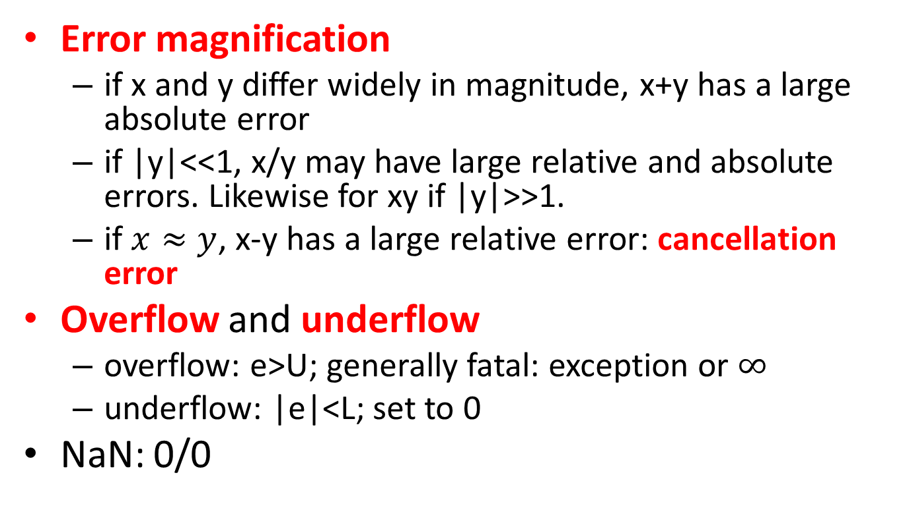
What to watch out for
Error magnification
if x and y differ widely in magnitude, x+y has a large absolute error
if |y|<<1, x/y may have large relative and absolute errors. Likewise for xy if |y|>>1.
if $x≈y$, x-y has a large relative error: cancellation error
Overflow and underflow
overflow: e>U; generally fatal: exception or $∞$
underflow: |e|<L; set to 0
NaN: 0/0

Slide 48
Cancellation
Subtracting 2 numbers of the same magnitude results in loss of accuracy.
123456789.1234567890
- 123456789.1234567891
=-000000000.0000000001
An algorithm is unstable if rounding errors can accumulate and result in significant errors at the end of the algorithm.

Slide 49
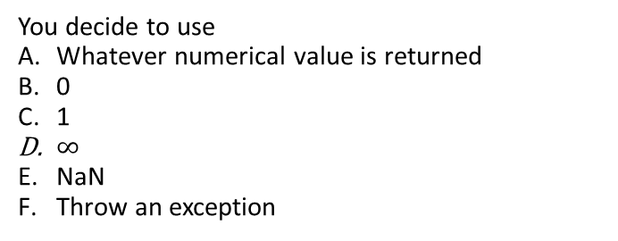
Question: the issue with 0/0
You decide to use
Whatever numerical value is returned
0
1
$∞$
NaN
Throw an exception
Notes:
C

Slide 50
LANCELOT Optimization library
function rho = computerho(s,f,g,fp,H);
eps = 10 * %eps;
dk = eps * max(1,abs(f));
df = fp - f - dk;
dm = g'*s + 0.5*s'*H*s - dk;//dm=m(x+s)-m(x)-dk
if (abs(df)<eps & abs(dm)<eps) | fp==f+g'*s+0.5*s'*H*s then
rho = 1;
else
rho = df / dm;
end
endfunction

Slide 51
Computer Arithmetic
What is round-off error?
IEEE 754-2008 Binary floating point arithmetic standard 754, replaces IEEE 754-1985
5 number formats: 32, 64, 128 binary, 2 decimals: 64, 128
5 rounding algorithms
Operations which must give same result as algorithm in the standard
total ordering
5 exceptions: invalid operation, division by 0, overflow, underflow, inexact
long real: 64-bit (binary digit) representation
first bit is a sign indicator: s
following 11 bits are the exponent/characteristic: c. Base of exponent is 2
following 52 bits are the binary fraction/mantissa: f.

Slide 52
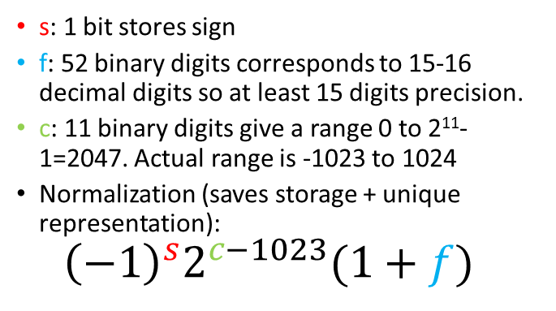
IEEE 754-2008 Binary floating point arithmetic standard
s: 1 bit stores sign
f: 52 binary digits corresponds to 15-16 decimal digits so at least 15 digits precision.
c: 11 binary digits give a range 0 to 2¹¹-1=2047. Actual range is -1023 to 1024
Normalization (saves storage + unique representation): ${\left(−1\right)}^{s}2^{c−1023}(1+f)$

Slide 53
Example
0 10000000011 10111001000100000000000000000000000000000000000000000000
0: +
10000000011=1027
101110010001…=2⁻¹+2⁻³+ 2⁻⁴+2⁻⁵+ 2⁻⁸+2⁻¹² = .56640625

Slide 54

Discrete Representation
Previous number represents an interval of numbers
Numbers less than 2⁻¹⁰²² (1+0) result in underflow (generally set to 0)‏
Numbers greater than 2¹⁰²³ (2-2⁻⁵²) result in overflow (generally stop the program)‏
Two representations for 0: $−0=+0$
positive zero: s=0,c=0,f=0 and
negative zero: s=1, c=0,f=0
+infinity = 1/+0 and –infinity = 1/-0
NaN = 0/0 = -infinity + infinity

Slide 55

Core principle: do not interrupt computation
Raising an exception is language dependent
To ensure compatibility use $∞$, NaN
+infinity = 1/+0 and –infinity = 1/-0
NaN = 0/0 = -infinity + infinity
It is up to the user to handle
$∞$
NaN

Slide 56
Errors
If you have $1000 and lose $1, should you be concerned? AbsErr = 1; RelErr = 0.1%
What if you have $10 and lose $1? AbsErr = 1; RelErr = 10%
Absolute loss (error) is the same but the effect is widely different!

Slide 57
Comparison summary
Numbers far from zero
use relative error
Number close to zero
use absolute error with eps value that depends on your problem/algorithm

Slide 58
How do you explain?
x == y is true but X.equals(Y) is false
x/(1+x*x) * x= 0.0 but 1/(1/x+x) * x= 1.0
(x+y)+z=1.0 but x+(y+z)=0.0
Notes:
1st: == tests memory address but equals tests values. NOT QUITE! Here x=+0 and y=-0. But Equals uses floatToIntBits(float)
2nd: large values: x=10^300
3rd: large values: x=10^300 y=-10^300 z=1

Slide 59
How do you explain?
x == y is true but X.equals(Y) is false [Java] == tests memory address; accounts for -0==+0 .equals uses floatToIntBits(float) in this example, x=+0, y=-0
true
false
public class CompareFloat{
public static void main(String []args){
System.out.println(+0==-0);
Double x,y; x=+0.0;y=-0.0;
System.out.println(x.equals(y));
}
}

Slide 60

How do you explain?
x/(1+x*x) * x= 0.0 but 1/(1/x+x) * x= 1.0 $x=1E300$ $1+x∗x=∞$ $x/(1+x∗x) = 1E300/∞$ =0 0*x=0 1/x=1E-300 1/x+x=1E300 1/(1/x+x)=1E-300 1/(1/x+x) * x= 1E-300 * 1E300 = 1.0

Slide 61
How do you explain?
(x+y)+z=1.0 but x+(y+z)=0.0 x=1E300, y=-1E300, z=1 x+y = 1E300 – 1E300 = 0 (x+y)+z= 0 + 1 = 1.0 y+z = -1E300 + 1 = -1E300 x+(y+z) = 1E300 -1E300 = 0.0

Slide 62
f=-3; for i=1:LIMIT f=1.4*f-0.2*f^2+3; printf("%3.0f, f=%2.20f\n",i,f); end;
Scilab 5.4: f=4.99999999999999910000 after LIMIT>=106
Matlab: f=4.9999999999999982 for even after LIMIT>=104 f=5.0000000000000009 for odd
OOo Calc: f=5 after LIMIT>=49
Ms Excel 2010: f=5 after LIMIT>=80
Java: f=-3 until at least LIMIT<=1,000,000
WHO IS WRONG???
Accumulation of rounding errors.
Java has the exact mathematical answer. The others follow IEEE 754
Notes:
Accumulation of rounding errors. Java is right. The others follow IEEE 754

Slide 63
Selected references
Jorge Nocedal and Stephen J. Wright: Numerical Optimization, Springer.
A.L. Peressini, F.E. Sullivan, and J.J. Uhl: The Mathematics of Nonlinear Programming, Springer.
For simple derivatives and Hessians: https://www.wolframalpha.com
Wikipedia

